Slide 1


CareAll - Earn By Caring

Slide 2
Objective
Objective
System Requirements
Use Case Diagram
Class Diagram
Entity Relationship Diagram
Code
Testing

Slide 3
Objective of CareAll - Earn by Caring
CareAll is a software build to deal with severe care shortage for the next decade.
Lot of people love caring & there are much more people who want care.
CareAll is a platform for making care as a service available.
There are two types of users in the platform - CareSeeker & CareProvider.
Careseeker will be buying care services & care provider will be earning money in return.
CareAll will be a platform to bring these two communities together.
Careseeker & Careprovider will be reviewed & rated by provider/seeker of the service.
EdYoda - Developer Programs
https://www.edyoda.com

Slide 4
Software System Requirements
User Profile creation & assign type of user.
Careprovider user should request careseeker if they need care.
CareSeeker should be able approve request.
CareProvider cannot send multiple requests to one CareSeeker.
CareProvider cannot have more than 4 careseeker at same time.
CareSeeker can have multiple CareProviders.
CareSeeker maintains minimum balance to employ CareProvider.
Paying careprovider money after every month and amount will be deducted from CareSeeker account and add’s to CareProvider account.
Free up CareProvider if not necessory to CareSeeker.
EdYoda - Developer Programs
https://www.edyoda.com

Slide 5
Hardware System Requirement
Python
MySQL database
EdYoda - Developer Programs
https://www.edyoda.com

Slide 6
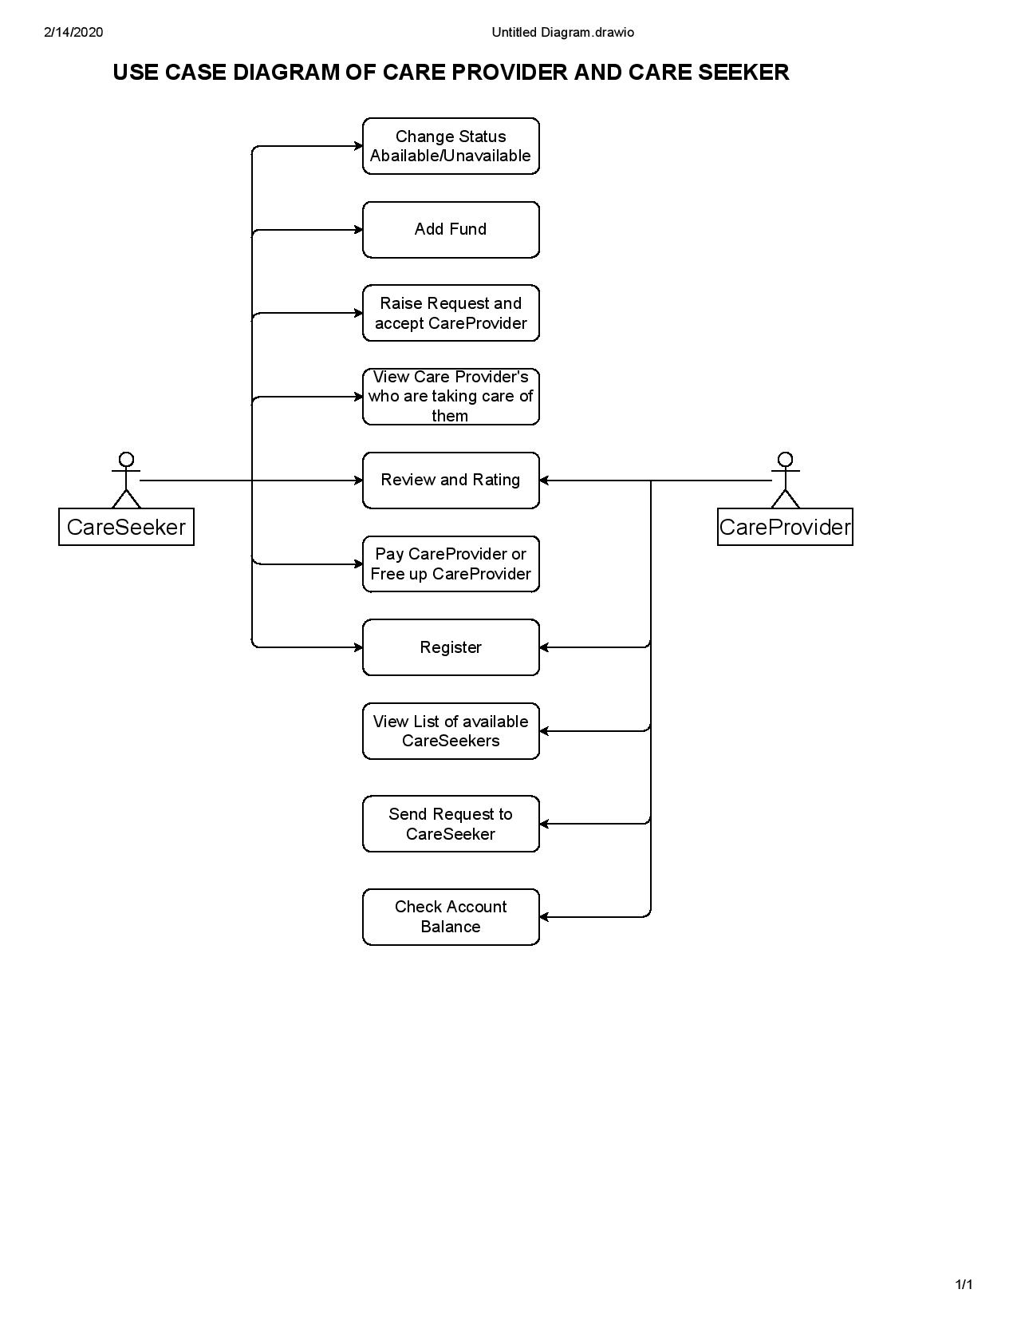
Use case Diagram
Actors
CareProvider
CareSeeker
System - Recommending, Search & Listing functionality, Manage Accout balance, Funds.
EdYoda - Developer Programs
https://www.edyoda.com

Slide 7
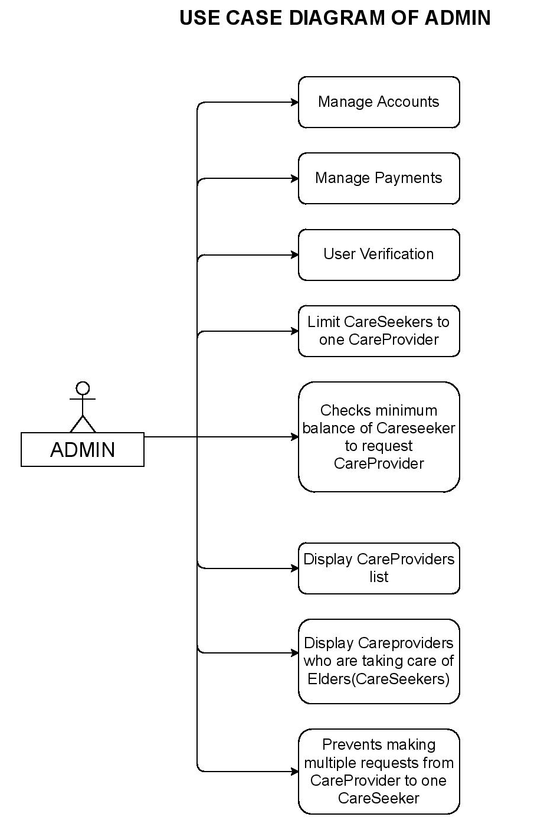
Use case Diagram
Actors
System - Recommending, Search & Listing functionality, Manage Accout balance, Funds.
EdYoda - Developer Programs
https://www.edyoda.com

Slide 8
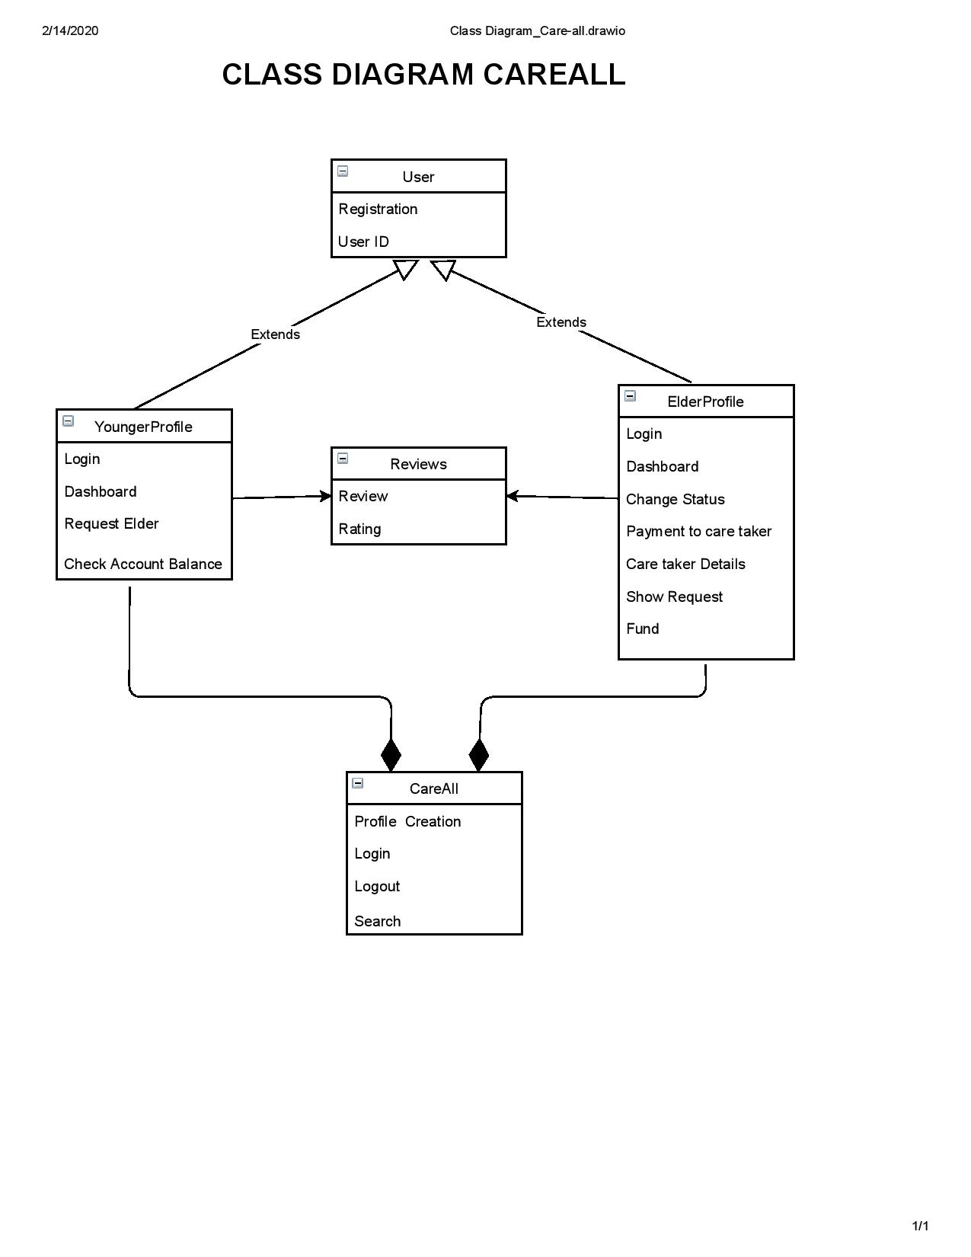
Class Diagram
EdYoda - Developer Programs
https://www.edyoda.com

Slide 9
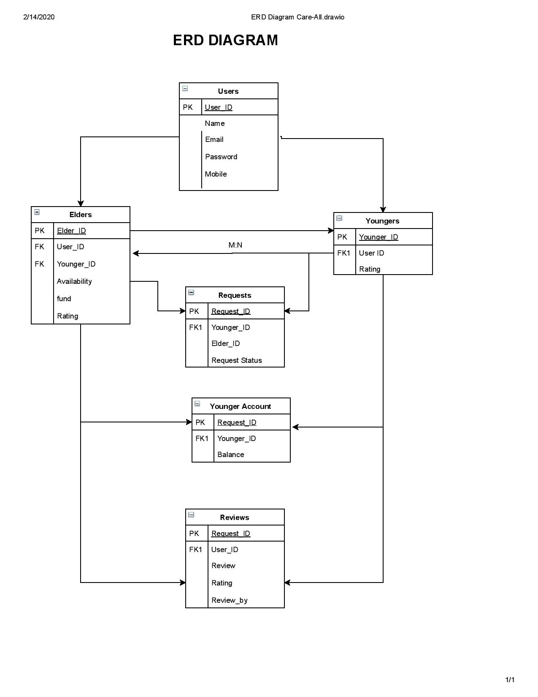
ERD Diagram
EdYoda - Developer Programs
https://www.edyoda.com

